Slide 1
Introduction to Artificial Intelligence, seen as humanity’s last invention
GodQuest Bennett, former Manager of Artificial Intelligence at AICE - Ai Center of Excellence via Adalabs Africa, lead Director of “A Practical/Rapid ~6+ Week Ai Course is all you need”, 1st known practical Neural Network Course with an Introduction to Artificial General Intelligence/Human Level Ai
Fun fact: This Practical course originally stemmed from an initiative to develop world’s 1st university, just for Artificial Intelligence. (See local newspaper articles by ASTI Ai Course Author, in 2018 and 2019)

Slide 2
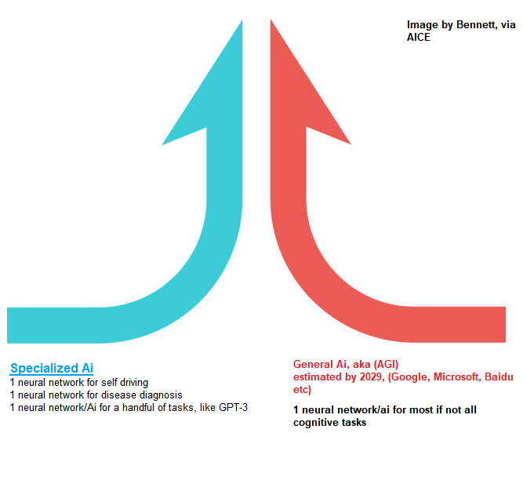
Why a form of Ai called AGI, may be our last invention as humans
See Prof Ben Gortzel (AGI Expert)
Also predicted to be possible by 2023, by Dr. Eray Ozkural!

Slide 3
Final note: Students should aim to contribute to AGI by joining our upcoming AGI department or others, or aiming to contribute code.
Google, Microsoft, Baidu etc are all openly working on General Ai (AGI). https://link.springer.com/article/10.1007/s00146-019-00887-x.
The trend has seen smaller companies/research/university bodies (like yourself!!) contributing algorithmically/academically to Ai research, and earning stake in that Giant share.
Author’s aim to contribute to AGI: God Bennett, had already began work with that direction in goal, since 2016, with a new form of Deep Learning called “Supersymmetric Deep Learning” as seen in the “Supersymmetric Artificial Neural Network” recently accepted to a String Theory Conference.
https://github.com/JordanMicahBennett/Supersymmetric-artificial-neural-network
Far more rigorous/actual AGI work concerning separate approaches, can also be seen in the following work (on arxiv etc) by Dr Eray Ozkural, one of the smartest people on the planet, whereby:
Dr Eray worked directly with people like Ray Solomonoff, Marvin Minsky, who helped originate the term Artificial Intelligence (See Dartmouth workshop)
Dr Eray won the 2015 Kurzweil Artificial General Intelligence award, awarded by Google’s Ray Kurzweil. https://www.youtube.com/watch?v=IT0YD-fd5CU

Slide 4
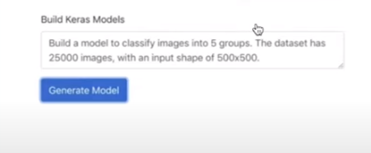
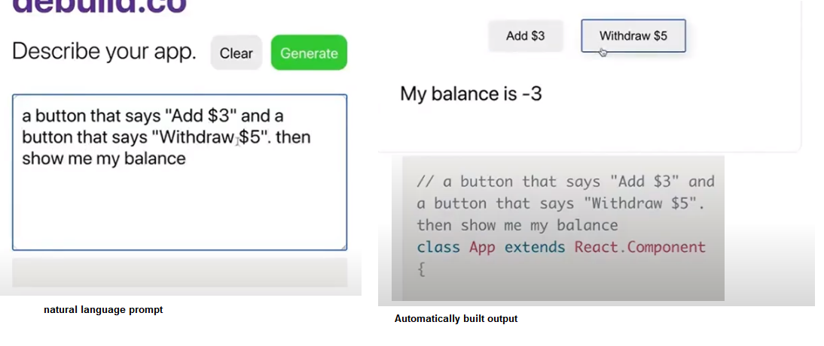
Key AGI forecasts and numbers to look at in relation to current Specialized AI
Gpt-3, can do automatically do machine learning based on simple natural language prompts. (Eg: Input: “Build a model to classify images into 5 groups…”. Output: Automatically built ML app!!!) SRC: https://youtu.be/cpWEXQkpBFQ?t=647
Gpt-3 can automatically do basic website UI development, again from simple natural language prompts. (Eg: Input: “a button that says Add $3 and a button that says “Withdraw $5”, then show me my balance”. Output: Automatically built ML app!!!) SRC:https://youtu.be/G6Z_S6hs29s?t=558
______________________________________________
Human brain has about 1000 trillion synapses or parameters.
With only 175 billion parameters, Gpt-3 can already do basic programming tasks, quite well. Google released a 1 trillion param model soon after the above.
It is predicted that Ai will do well at not just programming, but most if not all cognitive tasks, by about 15 trillion parameters. SRC: https://www.dataversity.net/are-we-a-1b-investment-away-from-general-ai/
This type of Ai (which I will discuss in the next slide quickly) is slated to arrive by around 2030 according to Google’s Ray Kurzweil.

Slide 5
Just imagine how impactful General Ai will be when it arrives in around 2030!
It is probably no coincidence that around the same time 800 million jobs is predicted to be lost, Ai is estimated to yield 15 trillion dollar market cap, and around same time AGI is predicted to emerge according to Google’s Ray Kurzweil (using laws of accelerating returns).
Prior non-ai technology (that automated human brawn/labour) had seen that humanity became more productive, and solved more issues. Specialized Ai (that is automating human brain) is seen as the a part of the final frontier, the final frontier in full being seen as our final invention, that does generalized tasks almost as well as we do or better.
Google, Microsoft, Baidu etc are all openly working on General Ai (aka AGI). https://link.springer.com/article/10.1007/s00146-019-00887-x.

